Slide 1
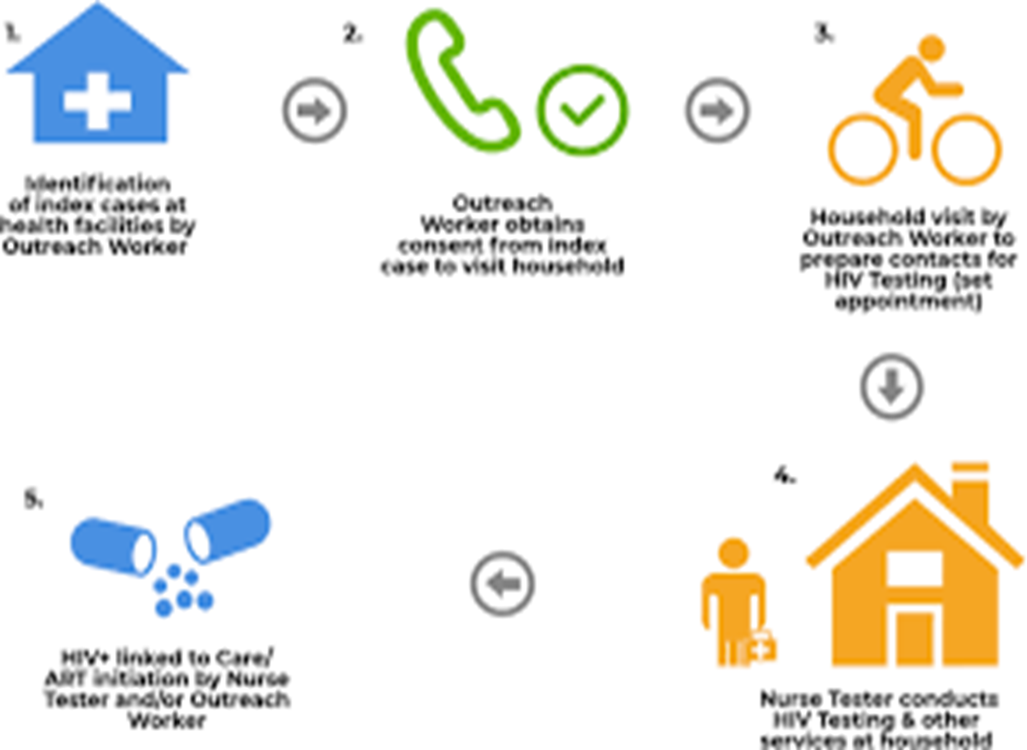
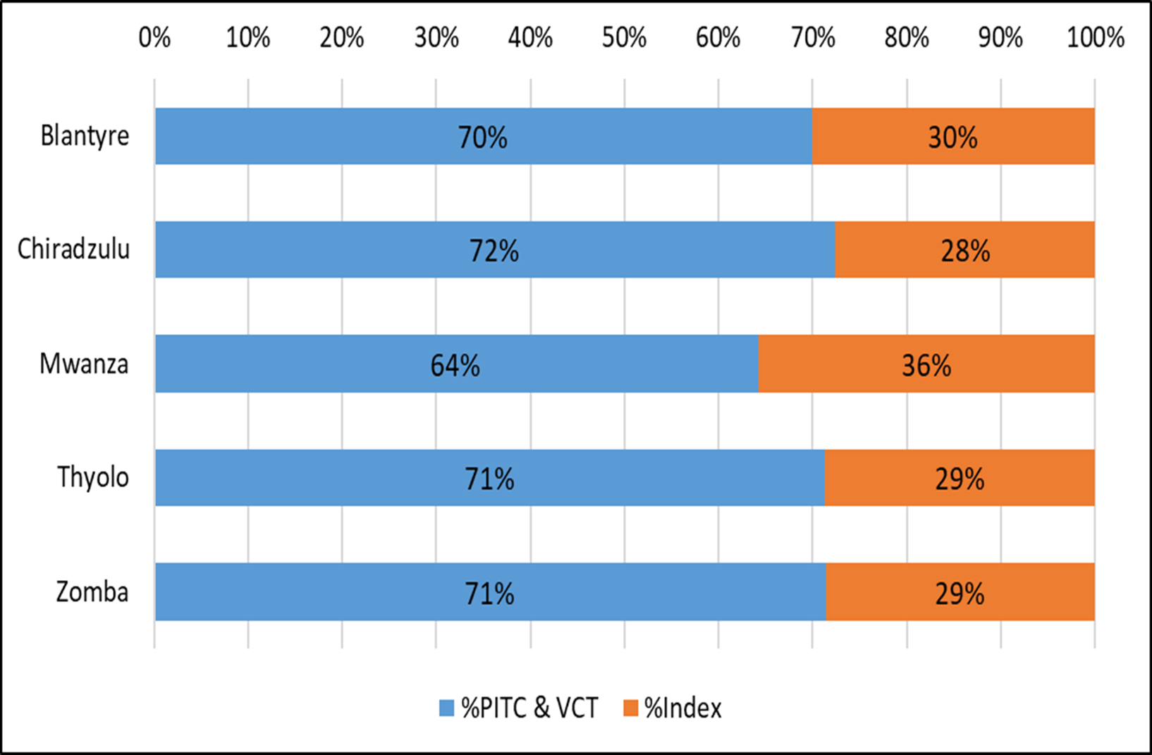
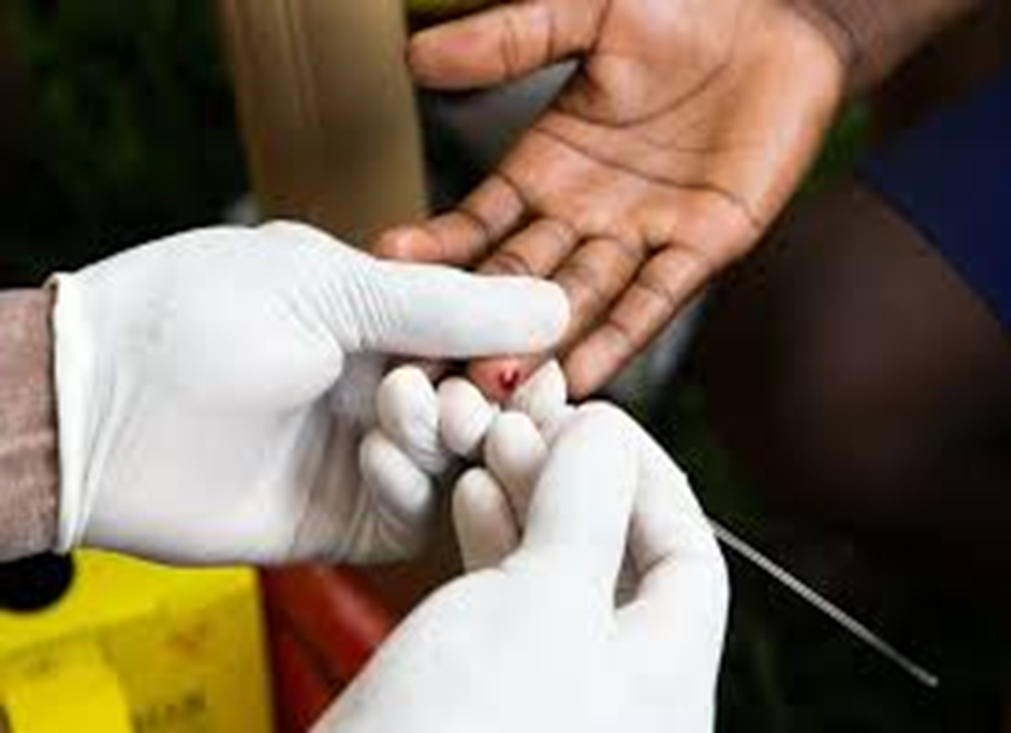
Exploring the contribution of Index testing in HIV case-finding in EGPAF-MACRO supported districts in Malawi: The case of Thyolo, Blantyre, Zomba, Mwanza and Chiradzulu
Patrick Mbulaje, MPH
(Project Manager, Malawi AIDS Counselling and Resource Organisation)
BACKGROUND
Elizabeth Glazer Paediatric AIDS Foundation (EGPAF) with support from Centres for Disease Control and Prevention (CDC) has sub granted Malawi AIDS Counseling and Resource Organisation (MACRO) to assist in HIV case finding in the districts of Thyolo, Chiradzulu, Blantyre, Zomba, and Mwanza.
HIV active and passive Index testing has been rarely used to improve HIV case-finding in sub-Saharan Africa because of concerns regarding privacy protection and possibly high costs. In Malawi, Active Index testing has been intensified since 2018 and this is now being widely introduced to the remaining districts where the prevalence of HIV is high based on the lessons learnt from the other districts.
METHODS
We estimate the contribution of identifying an undiagnosed HIV infection through index testing compared to client-initiated voluntary Counseling and testing (VCT) and provider-initiated testing and counselling (PITC). We used data from 1st Quarter of 2019 Country Operation Plan (COP 19) to inform these calculations so that we ascertain the contributions that index testing has done in HIV case finding.
RESULTS
In the 5 implementing districts, the probability of clients offered HIV index testing and accepting ranged from 78% to 100% giving the average index testing acceptance rate of 85% across the districts. HIV prevalence ranged from 8% to 47% among the partners who were tested with the average HIV prevalence for all the districts standing at 13%.
The average HIV positive contribution of PITC and VCT was 70% against 30% in Index testing across the districts. Mwanza registered a higher contribution from Index testing with 36% and the lowest was Chiradzulu with 28% contribution.
DISCUSSION
Partner notification programmes, offering HIV testing to the sexual partners of people newly diagnosed with HIV, have rarely been implemented in African countries, but can be highly effective if well implemented. The data presented provides strong evidence in favour of integrating partner notification into HIV testing services in health facilities in sub-Saharan Africa.
CONCLUSION
Intensified active and passive index testing contributes greatly to HIV case finding and complements client-initiated VCT and PITC in a large number of populations affected by generalized epidemics of varying magnitudes.
REFERENCES
Cherutich P et al. Effectiveness of partner services for HIV in Kenya: a cluster randomized trial. Conference on Retroviruses and Opportunistic Infections, Boston, abstract 50, 2016.
Hogben M, McNally T, McPheeters M, Hutchinson AB. The effectiveness of HIV partner counseling and referral services in increasing identification of HIV-positive individuals a systematic review. Am J Prev Med. 2007 Aug;33(2 Suppl):S89–100.
PRESENTED AT THE 23RD INTERNATIONAL AIDS CONFERENCE (AIDS 2020) | 6-10 JULY 2020

